Slide 1

Key Case Studies in Republic of Moldova
Name of Channel Organization
Vectro Grup SRL
D-U-N-S Number 535128683
Name of Presenter(s)
Administrator Svetlana Cojohari
Engineer Corneliu Ciobanu
Date 17.01.2017

Slide 2
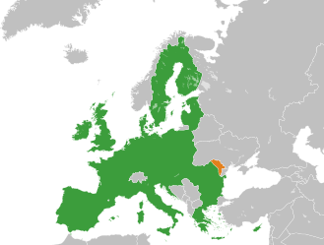
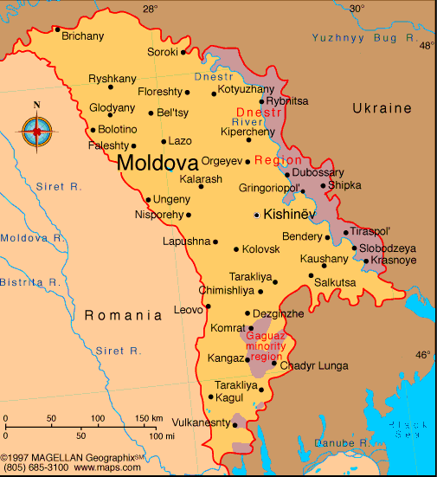
Channel Organization - Overview
Vectro Grup SRL is covering the entire territory of Republic of Moldova.

Slide 3
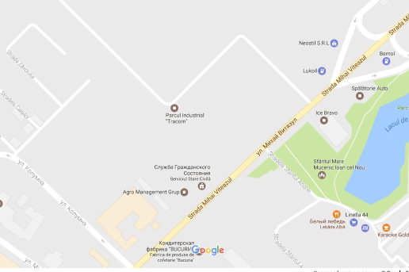
Channel Organization - Overview
Our office is located at 170/3, Columna Street , Chisinau , 2004, Republic of Moldova
SC Vectro Grup SRL

Slide 4
Channel Organization - Overview
Private Owner
Administrator
Finance Director
Accountants
Technical Director
Project Managers
Engineers/
Sales Managers
Workers
Designers/ Sales Managers
Drivers
Vectro Grup SRL
Organizational structure

Slide 5
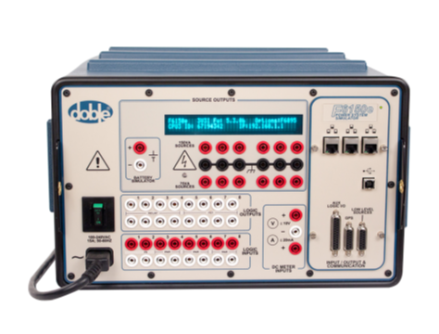

Channel Organization - Overview
We have been with DOBLE 9 years (since 2008), and Vectro Grup SRL do not represent any other company.
Our specialists are acknowledged with DOBLE production from 2001, when Moldelectrica had purchased his first F6150 (totally between 2001 and 2007 4 pcs F6150 and 1 pcs F6300).

Slide 6
Channel Organization - Overview

Slide 7
Channel Organization - Overview
Our key customers in the Republic of Moldova

Slide 9
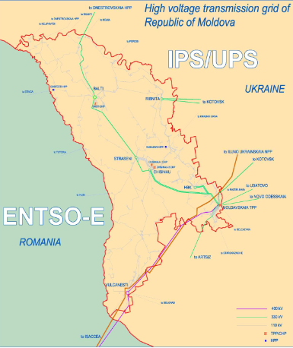
Channel Organization - Overview
1. State Enterprize IS Moldelectrica is a company specialized in services of transportation and operative dispatching of energetic system of Republic of Moldova. This company is the main Electric System Transmission Operator in our country.
Voltage levels of transmission: 400 kV, 330 kV, 110 kV. Voltage levels of distribution: 35 kV, 10 kV, 6 kV.

Slide 10
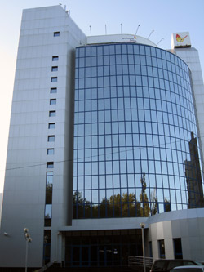
Channel Organization - Overview
2. Gas Natural Fenosa, pioneer in gas and electricity integration, is a multinational group operating in more than 30 countries and with over 23 million customers. This company has been operating in Moldova since 2000 and provides a service to over 0.8 million customers via its subsidiary ICS Red Unión Fenosa SA .
ICS Red Unión Fenosa SA central office in Chisinau

Slide 11
Channel Organization - Overview
This company is engaged in electricity distribution in the central and southern regions of the country, including the capital (Chișinău).
Voltage levels of distribution:
35 kV, 10 kV, 6 kV.

Slide 12
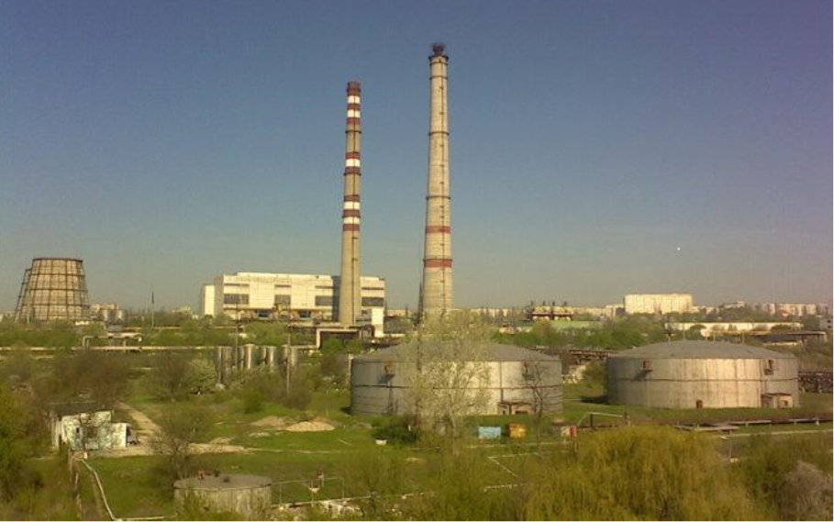
Channel Organization - Overview
3. Joint-Stock Company Termoelectrica S.A. is the main heat generator and supplier in Chisinau and its suburbs.

Slide 13
Channel Organization - Overview
The enterprise object is electricity; production, transportation and distribution of heat (the term includes hot water and heating) to the consumers. Also, Termoelectrica S.A. supplies electricity. The average value of electricity produced is:
During winter: Source 1 – 182 MW; Source 2 – 25 MW;
During summer: Source 1 – 42 MW.

Slide 14
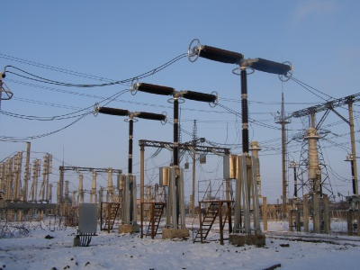
Channel Organization - Overview
4. State Unitary Enterprize GC Dniester Energo is a company specialized in services of transportation and operative dispatching of energetic system of Dniester Region.
Voltage levels of transmission:
330 kV, 110 kV.
Voltage levels of distribution:
35 kV, 10 kV, 6 kV.

Slide 15

Channel Organization - Overview
5. Tirotex - is a textile company with 40-years history and an annual turnover exceeding 100 mln USD. It is a vertically integrated company with a complete production cycle: from cotton processing to ready-made articles.

Slide 16
Successful Sales – IS Moldelectrica
We have had successful sales to IS Moldelectrica in 2008 (F6150- 3 pcs), 2009 (spare parts F6150), 2011 (spare parts F6150), 2016 (F6150SV-1 pcs).
Vectro Grup SRL has very tight working liaisons with this major company in RM from our foundation. We are specialized in montage and commissioning of Relay Protection and Control or SCADA microprocessor terminals.

Slide 17
Successful Sales – IS Moldelectrica
The implementation of microprocessor terminals is challenging us for very complex methods of commissioning. Then we have purchased a F6150 Power system simulator for our specialists use. Therefore, we know this equipment quite well. Moreover, our engineers have had taken training courses on using F6150 at Moldelectrica Training Center. The secret of success is in a very good combination of tight work relationship with Moldelectrica specialists, a strong quality of the power system simulators, and last but not least, a good pricing.

Slide 18
Successful Sales - ICS RED Union Fenosa SA
We have had successful sales to ICS RED Union Fenosa SA in 2008 (F6150- 1 pcs). Vectro Grup SRL has also very good relationships with this company. Unfortunately, the 2007-2010 financial crisis had forced the company politics to the austerity measures. Other disturbing factor is the orientation of EU companies to OMICRON solutions. But we won due to a better pricing.

Slide 19
Successful Sales - Termoelectrica S.A.
We have had successful sales to Termoelectrica S.A. in 2012 (F6150- 1 pcs). Vectro Grup SRL has also very good relationships with this company. Unfortunately, the 2007-2010 financial crisis also had forced the company politics to the austerity measures. Other disturbing factor was the orientation to Russian RETOM solutions, due to a big number of old Soviet protections used by Termoelectrica S.A. RETOM give to customer a big number of automated tests for this protections. There we won due to a better usability of DOBLE production for the new MP terminals.

Slide 20
Lost Sales - TIROTEX
We have had unsuccessful sales to Tirotex in 2010 (F6150- 1 pcs). Vectro Grup SRL has also very good relationships with this company. Unfortunately, the 2007-2010 financial crisis also had forced the company politics to the austerity measures. Other disturbing factor was the orientation to Russian RETOM solutions, due to a big number of old Soviet protections used by Tirotex . RETOM give to customer a big number of automated tests for this protections and manuals in Russian. However we were quite convincing , but the financial problems are not let us to succeed. Finally, Tirotex had purchased anything.

Slide 21
Lost Sales – IS Moldelectrica
We have had unsuccessful sales to IS Moldelectrica in 2015 (On-Line Test Sets). The only one objection to our proposal was the pricing. But we think to show to the customer the big opportunities offered by this equipment and made it finally.

Slide 22
Lost Sales - GC Dniester Energo
We have had unsuccessful sales to GC Dniester Energo in 2015 (F6150- 1 pcs). Vectro Grup SRL has also very good relationships with this company. Unfortunately, the Dniester Region crisis also had forced the company politics to the austerity measures. Other disturbing factor also was the orientation to Russian RETOM solutions, due to a big number of old Soviet protections used by Tirotex . RETOM give to customer a big number of automated tests for this protections and manuals in Russian. It was a major factor against our proposal and finaly von RETOM.

Slide 23
Case Studies – Key Points
In general, the trends of our sales of DOBLE products follows the world economy trends ups and downs. However, we have a clear conception how to succeed.
The strong point of DOBLE products is their traditionaly reliability and durability. We consider it will certainly remain.
The week point in our market is documentation. It is only in English, but our customers demand from us Russian manuals.
The soft was also a week point comparative to OMICRON soft. Now it is better, we recommend to work further on it. On the other hand, it was free and this was a very strong point. Therefore, a good balance is needed.

Slide 24
Case Studies – Key Points
4. Free training courses are badly demanded by our customers during the sell negotiations.
We have to work together to formulate a adequate pricing policy according to our region challenges.
5. We are very pleased to work with DOBLE company and we are hoping to a long and fruitful collaboration.

